Slide 1

“DETECT AND REPORT ONLINE BULLYING”
Capstone Project AI -PE
TEAM – 21
18K41A0505 Areefa
18K41A0415 G. Leena
18K41A0556 Sriabhinay Kusuma
18K41A0232 Mohammad Saifuddin
Mentor: Mr. S. Naresh

Slide 2

PROBLEM & NEED STATEMENT
Social media is serving majorly in all ways but on the other side, it is being misused in troubling the users by harassing, stalking, and blackmailing.
From all among cyber attacks, the most availing is the online bullying. It has become extremely common, especially among the teenagers, as the digital sphere expanded.
Need Statement:
“To build an ML model that could detect the bullying in comments section and could identify whether the account is fake or not and report it.”

Slide 3
EXISTING SYSTEM
In a recent study on cyberbullying detection, gender-specific features were used and users are categorized into male and female groups. It is limited only to gender features. In another study, NUM and NORM features were devised by assigning a severity level to the bad words list (nosewaring.com).
It showed only 58.5% accuracy, which is very less accurate.
In using a bag-of-words approach examined a baseline text mining system and improved but even with those models, a vector machine learner produces a recall level of 61.9%.
Thus, main problem is less accuracy

Slide 4
PROPOSED MODEL
The proposed system involves the application of ML models with the support of NLTK (Natural Language Tool Kit) which runs in the backend and classifies the comments and the bullying probability rate.
We applied different algorithms over our model like Linear Regression, Decision Tree Classifier, Naïve Bayes, KNN, Random Forest and analyzed the best accuracy of about 94.36% with the Random Forest Algorithm. Thus, we got good accuracy in our case when compared to the existing model.

Slide 5
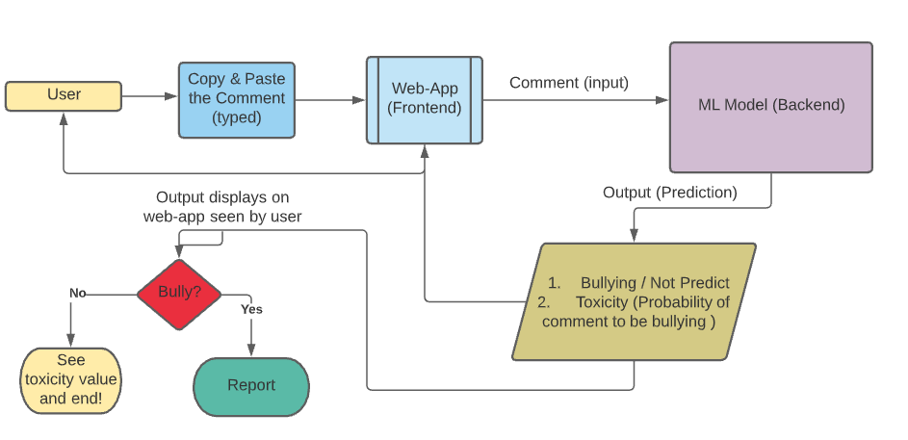
PROPOSED MODEL IN DETAIL

Slide 6
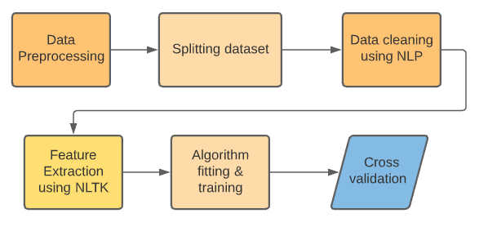
MODEL IMPLEMENTATION

Slide 7
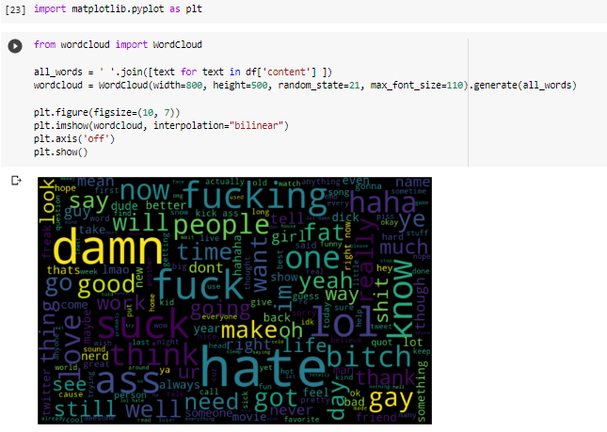
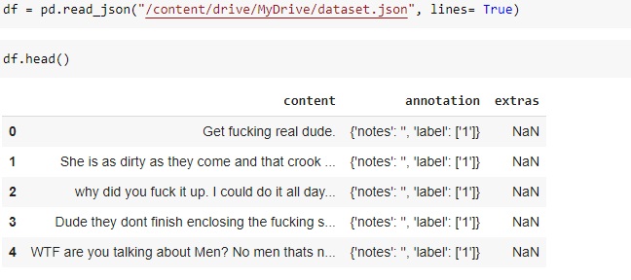
DATASET - VISUALIZATION
Visualization of frequent words in comments (dataset column:content)
The specific dataset used which has tweets labeled as a bully or not for the prevention of trolls over social media like Twitter. It was hosted on Kaggle in JSON format. The shape of the dataset is (20001,3)

Slide 8
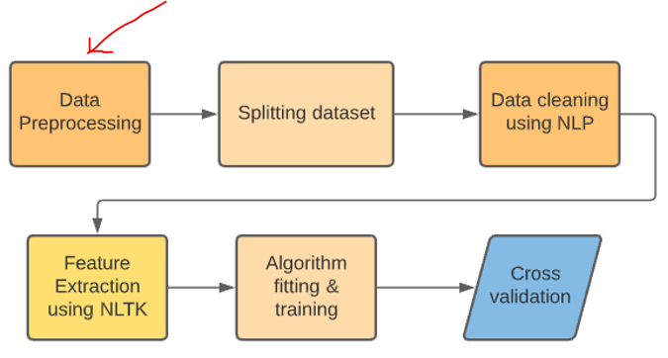

Slide 9
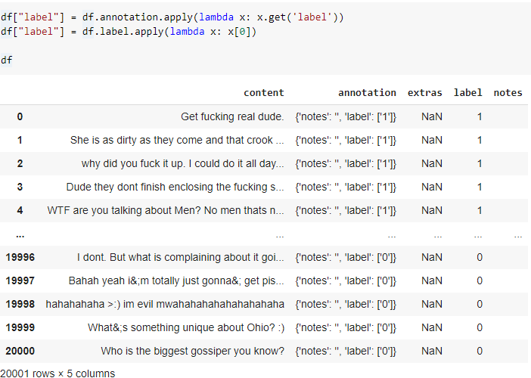
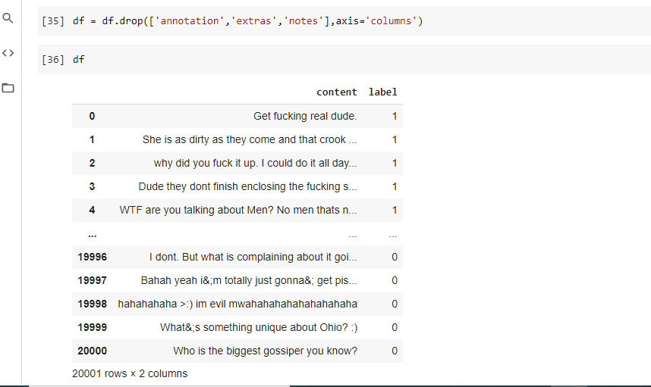
DATA PREPROCESSING

Slide 10
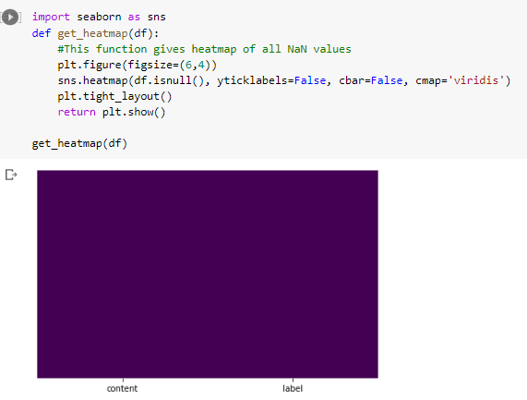
Let’s now check whether there are Nan values

Slide 11
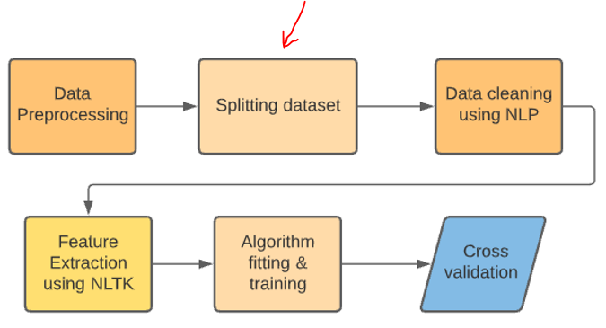

Slide 12
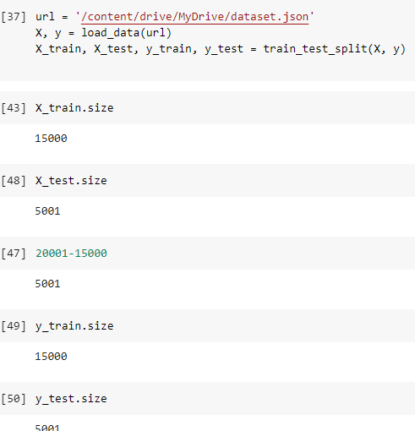
Splitting the data (Training and testing set)
MAIN PURPOSE IS FOR CROSS VALIDATION
Train-Test split is a technique that is usually used for cross-validation for evaluating our model via the performance of the ML algorithm applied.
Training Dataset: used to fit the ML model (for training model)
Test Dataset: used to validate the fitted ML model
Import from sklearn library:
from sklearn.model_selection import train_test_split

Slide 13
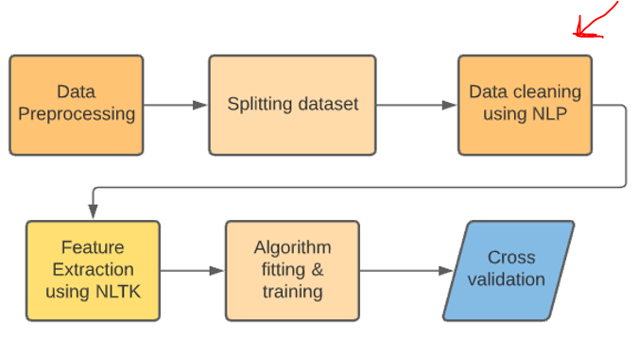

Slide 14
Steps for Data cleaning using NLP
Removing all non-alphanumeric characters (irrelevant ones)
Bringing all the characters to its lowercase
Performing Tokenization (split the whole text into individual words)
Perform Lemmatization
Before we use text for modeling we need to process it. The steps include removing stop words, lemmatizing, stemming, tokenization, and vectorization.

Slide 15
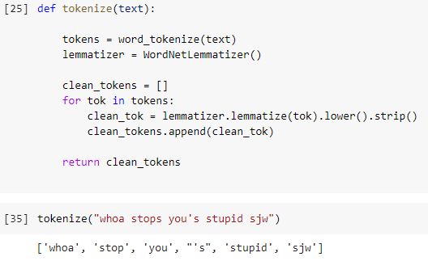
STEPS FOR TEXTUAL DATA CLEANING USING NLP
Tokenization is the process by which big quantity of text is divided into smaller parts called tokens.
LEMMATIZATION: Lemmatization is the process of converting a word to its base form. – To obtain the intended meaning of the word according to the vocabulary (NLTK) The difference between stemming and lemmatization is, lemmatization considers the context and converts the word to its meaningful base form, whereas stemming just removes the last few characters, often leading to incorrect meanings and spelling errors.
Used - Wordnet Lemmatizer:
Wordnet is an large, freely and publicly available lexical database for the English language aiming to establish structured semantic relationships between words. It offers lemmatization capabilities as well and is one of the earliest and most commonly used lemmatizers.

Slide 16
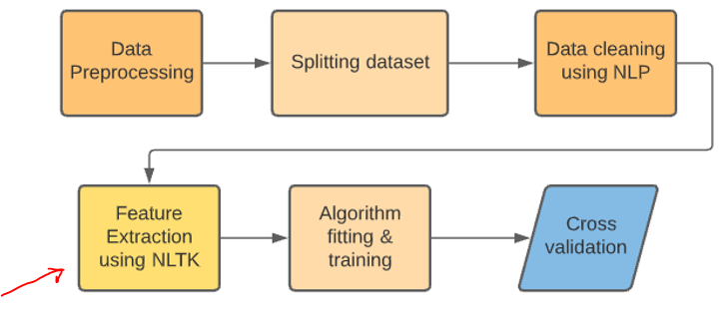

Slide 17
Feature extraction techniques from text used
Vectorization is a process of converting the text data into a machine-readable form. The words are represented as vectors.
Countvectorizer:
CountVectorizer tokenizes(tokenization means breaking down a sentence or paragraph or any text into words) the text along with performing very basic preprocessing like removing the punctuation marks, converting all the words to lowercase, etc.
An encoded vector is returned with a length of the entire vocabulary and an integer count for the number of times each word appeared in the document. (training data – fit_tranform () and testing data – transform())
This is how our vocab looks like.

Slide 18
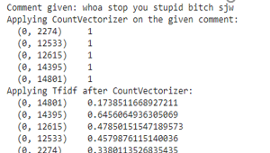
TF-IDF stands for Term Frequency-Inverse Document Frequency
“Term frequency–inverse document frequency, is a numerical statistic that is intended to reflect how important a word is to a document in a collection or corpus.”
Term Frequency: is a scoring of the frequency of the word in the current document.
Inverse Document Frequency: is a scoring of how rare the word is across documents.
Rank the words:
The closer to 0 – the common the word (prepositions etc.…)
Closer to 1 - rare word
Highlight the unique and relevant words in particular comment.

Slide 19
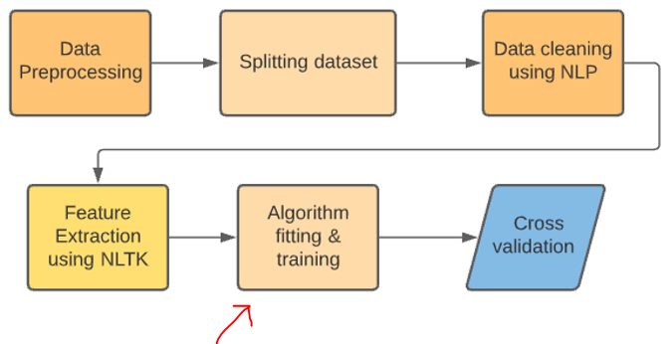

Slide 20
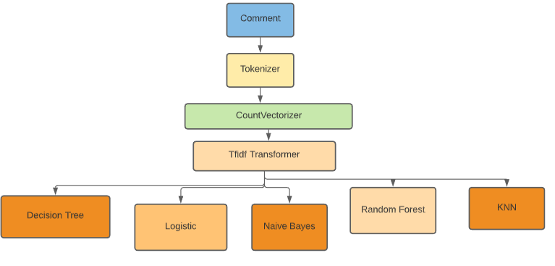
Flow

Slide 21
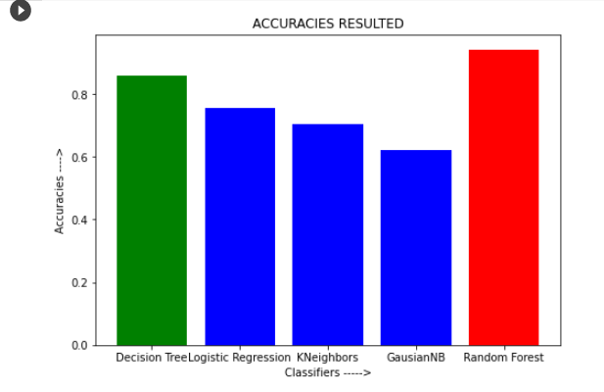
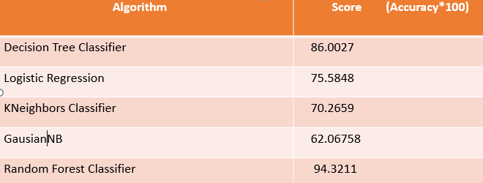
Algorithms - Scores Obtained

Slide 22
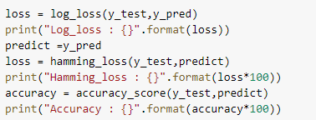
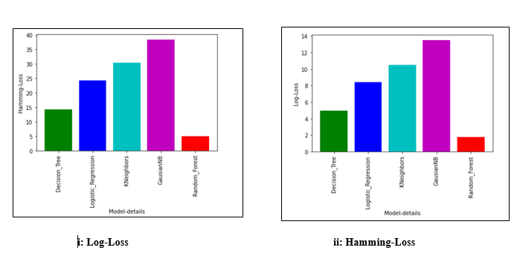
Analysis – Evaluation Metrics
a low Log Loss means a low uncertainty/entropy of your model
Log Loss it useful to compare models not only on their output but on their probabilistic outcome.
fraction of labels that are incorrectly predicted.
Notes:
It is a measure of uncertainty (you may call it entropy), so a low Log Loss means a low uncertainty/entropy of your model. Log Loss is similar to the Accuracy, but it will favor models that distinguish more strongly the classes. Log Loss it useful to compare models not only on their output but on their probabilistic outcome.

Slide 23
Why Random Forest?
When we want our model to be simple to interpret and to overfit – Decision Tree Classifier
When not concerned about interpretation but only for accurate prediction – Random Forest (Builds multiple trees and merge all of them to get stable prediction)
Though Random Forest reduces variance and does not perform well on training dataset when compared to decision tree classifier, always wins in terms of accuracy when an unexpected test case given.
In our case, Predicting real time bullying comments – Accuracy factor plays role.
That’s why we used Random Forest Algorithm for our model!!!

Slide 24
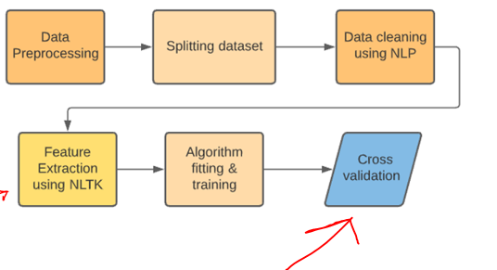

Slide 25
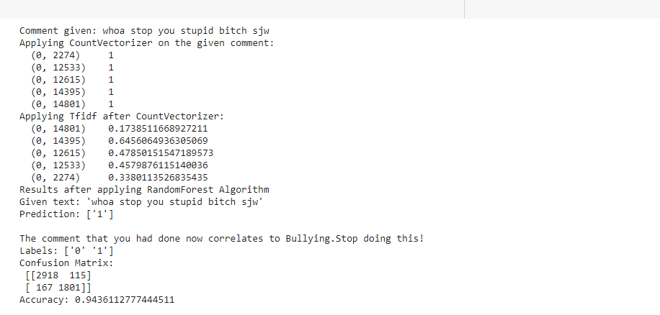
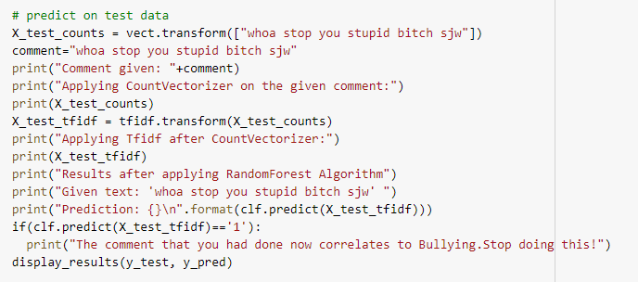
Validation

Slide 26
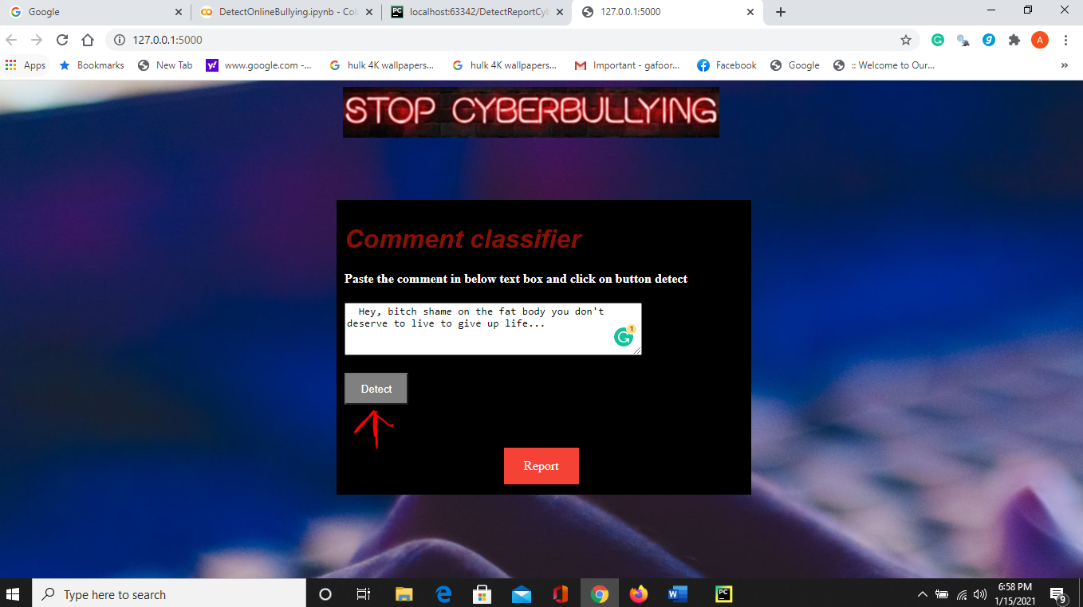
Deployment – Flask App

Slide 27

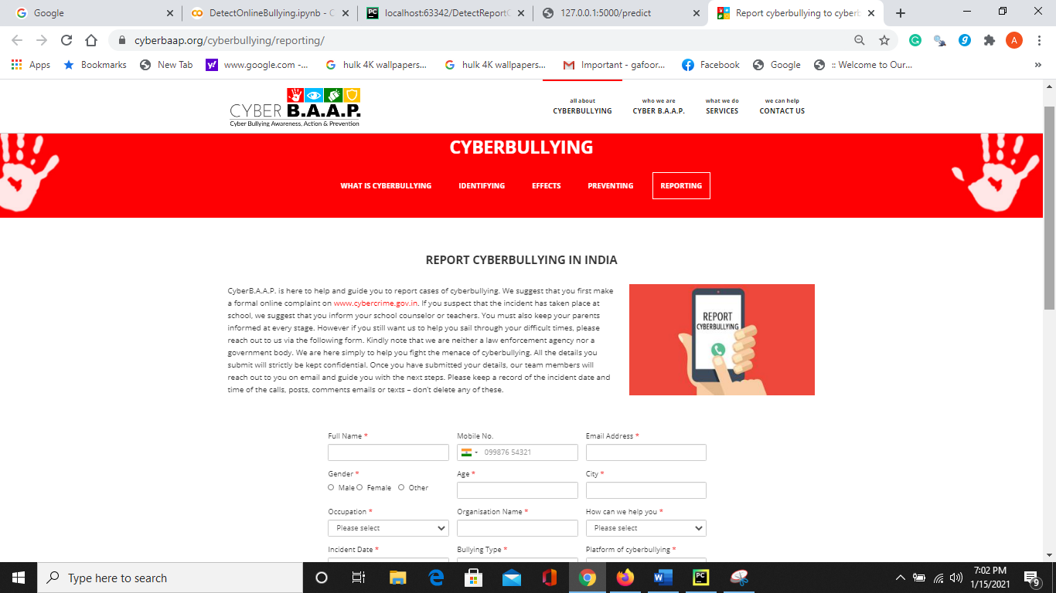

Slide 28
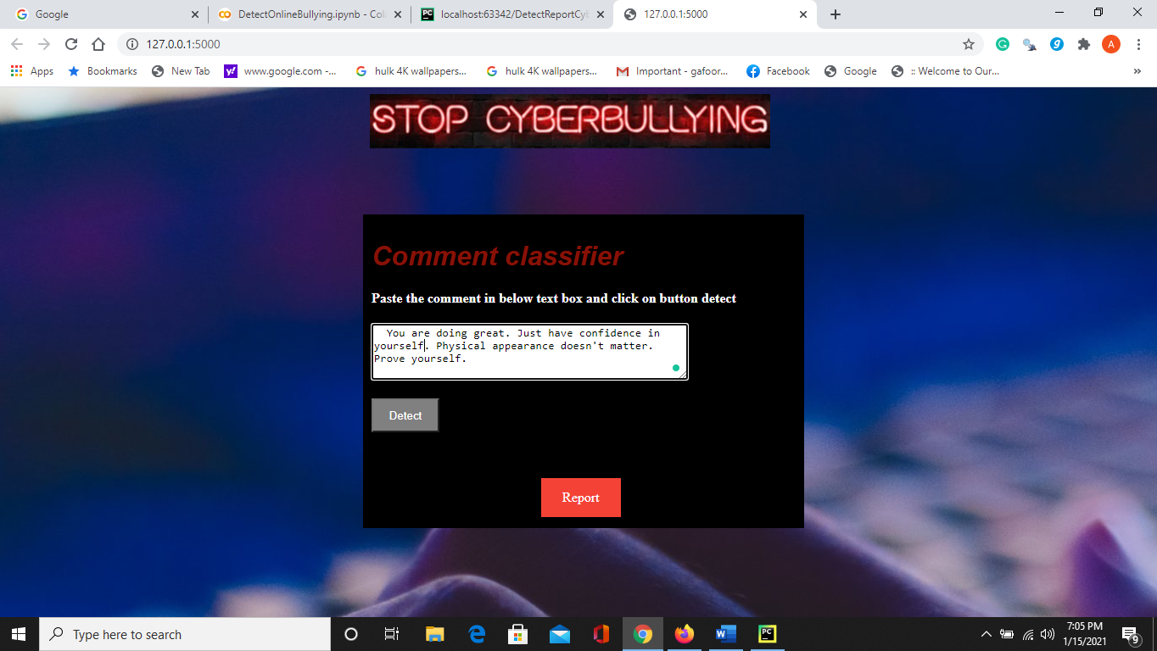
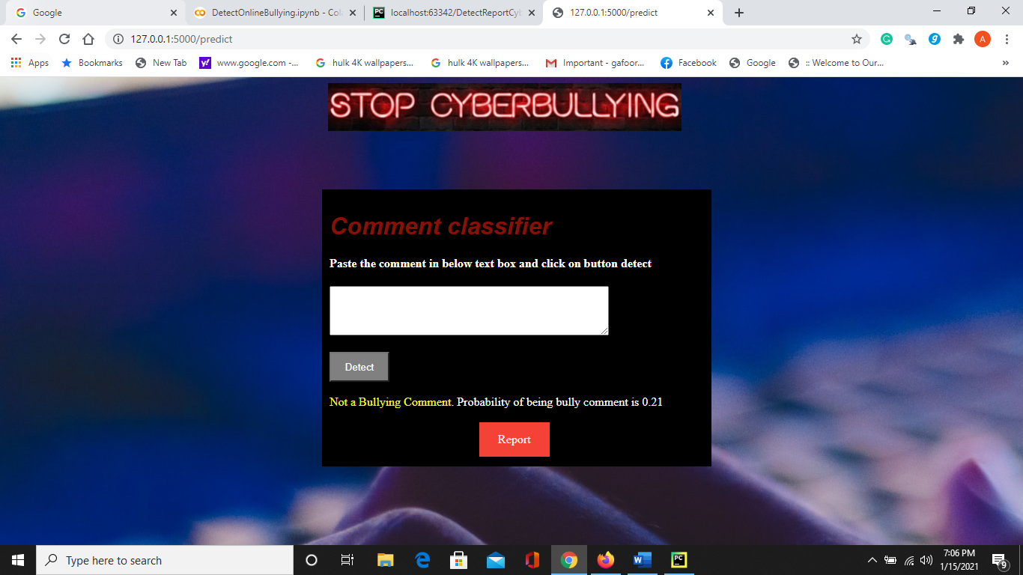

Slide 29
Conclusion
It is very important to think before posting a comment over another’s feed because that can affect the person mentally. It is better to have a look over the comments that we post by using the web apps that depict the probability of the comment being abusive.
Even when we come across suspicious bully comments, it is better to paste them into the web app and find the prediction. Relatively report the account along with the proof of prediction from web app to the officials like CyberB.A.A.P
The present proposed model in this paper is trained by the Random Forest Algorithm with attained 94.32% accuracy and run behind the Flask app. The Web-App proposed is user friendly and easy for the user to make use of it and make decisions.

Slide 30
Future Scope
The further enhancements can be done by creating the extensions or plugin of the Web-App or model to the social media whereby automatic detection of comment as bullying displays as a warning while the person is typing and even resist that person from posting that comment.
We can increase the performance of model by exposing it to the huge real time datasets and make it learn from its experiencing even.

Slide 31

THANK YOU!
Thus, at last, we would say that we should be very conscious of social media and report the accounts that try harassing people and beware of trolling as well as have a check on comments that you post.
Let’s use the boons of social media without diverting towards the dark side!
Google Colab Link: https://colab.research.google.com/drive/1hNuG30k4ToHT5zcflib2w0cYSKDTVDVC#scrollTo=67Y--L6dG7ZD

